Slide 1











From the bottom of our Heart,We Welcomes you to our project

Slide 2
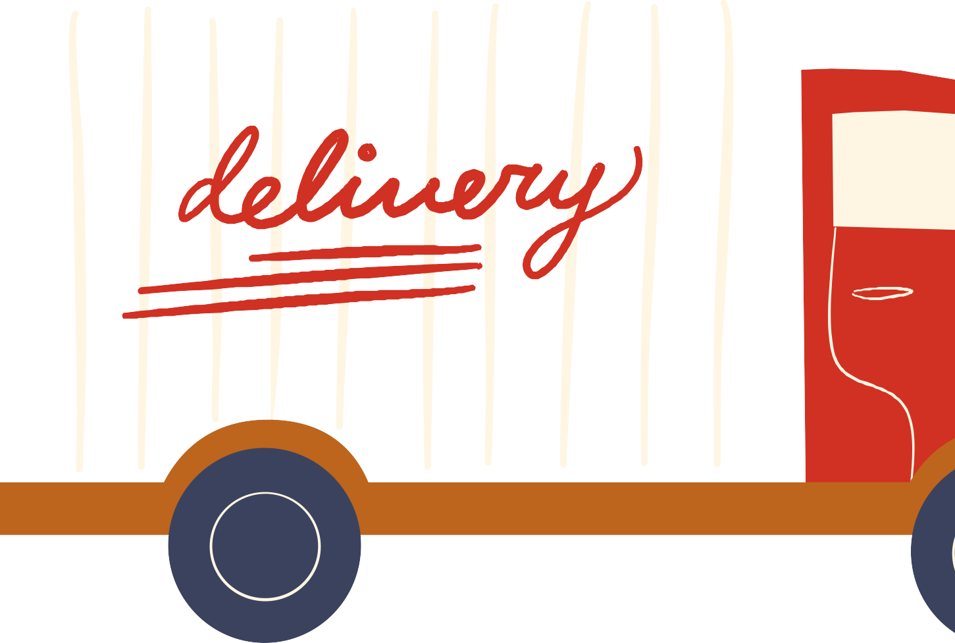


Topic Outline
1
Introduction
2
Problem Statement
3
Project Objectives
4
Study of existing system
5
Solution Proposed
6
Use case diagram

Slide 3



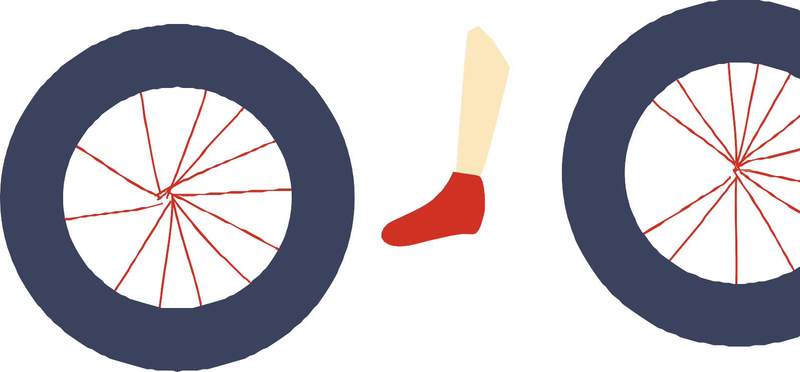
Introduction
Milk Distribution and Billing System
This Milk Distribution and Billing System project created based on WEB Presentation Technologies.....

Slide 4





Meet the Team
Akshat Shrivastava 0827CI201020
Ayush Singh
0827CI201050
Akash Jain
0827CI202017

Slide 5

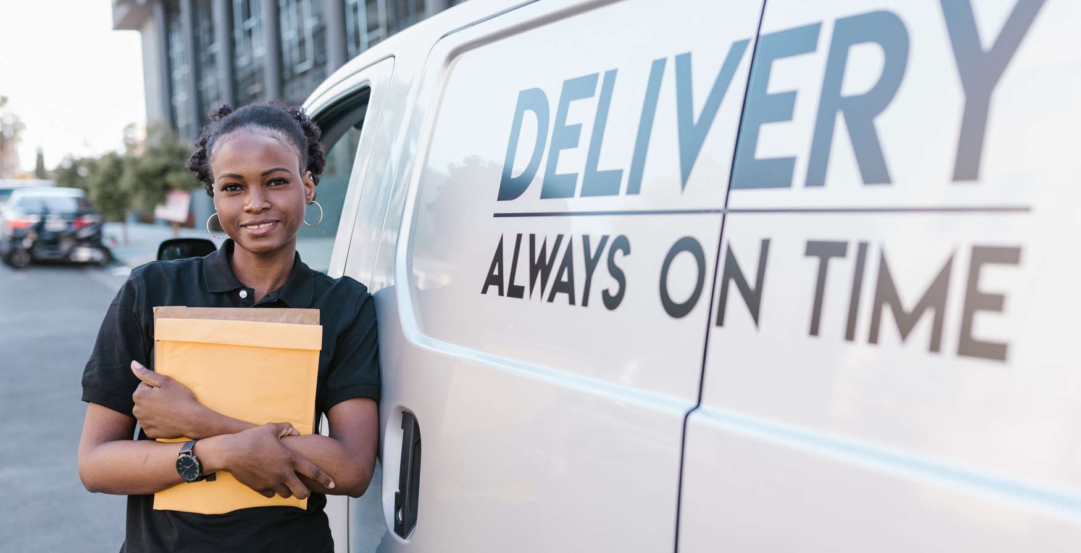

Project guidance
Project is guided and acknowledged by:
Prof. Garima Joshi

Slide 6

Problem Statement
Milk Distribution and Billing System is a software-based program that functions as a dairy software to keep track of daily milk production for registered account members (dairy manager). Customers can access the customer ledger page by logging in.

Slide 7


Problem Objectives
Milk Distribution and Billing System is used to keep track of dairy, members, and customers, as well as milk collections from members, sales to customers, and plant operations. Collection managers can use the Dairy Management System’s rate card functionality to collect milk of various fats at the correct cost.

Slide 8

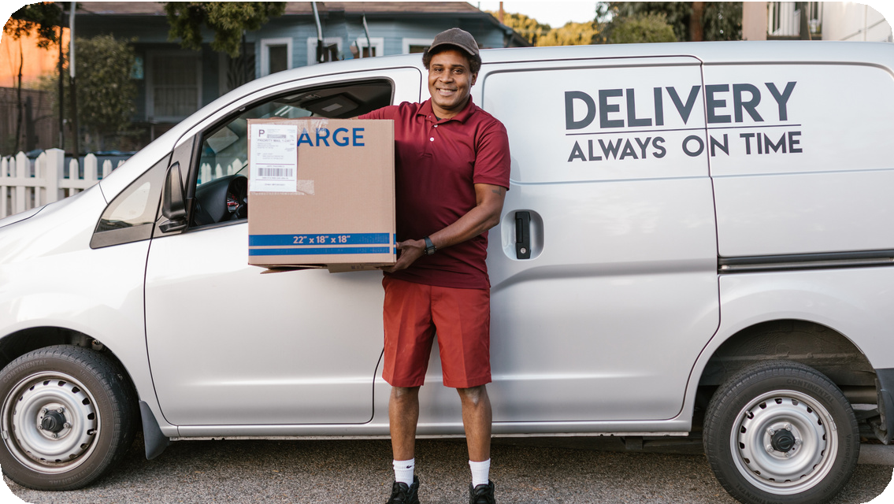


Proposed
Existing
Time consumption: : As the records are to be manually maintained it consumes a lot of time. Paper work: o Lot of paper work is involved as the records are maintained in the files & registers Storage requirements: o As files and registers are used the storage space requirement is increased.
Less reliable: o Use of papers for storing valuable data information is not at all reliable.
Accuracy: o As the system is in manual there are lot many chances of human errors. These can cause errors in calculating mechanism or maintaining customer details. Difficulty in keeping new records: o It is difficult for keeping all the new entries of members, their account and transaction details.
The proposed system is managed by the Python, which are user friendly windows for every user and for maintaining the database SQLite3 is used. The system proposed has many advantages. 1. The proposed system is highly secured, because for login the system it requires the username and password which is different for each department therefore providing each department a different view of the customer information. 2. It provides wide range of certain criteria in each window the client is working for better and quicker solution. 3. It maintains report for all criteria and transactions.

Slide 9


Admin Features
The admin account can be created using createsuperuser command. Administrator Can Add Vendors.
Administrator Can Add Milk Category For Related Vendor.
Admin Can See All The Vendors Dashboard.
Admin Can See The Individual Vendor Ledger.
Administrator Can Add Customers After Register An User.
Admin Can Add Milk Category For Related Customer.
Admin Can See All The Customers Dashboard. Administrator Can See The Individual Customer Ledger.

Slide 10



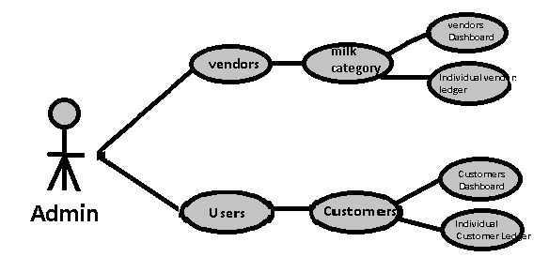



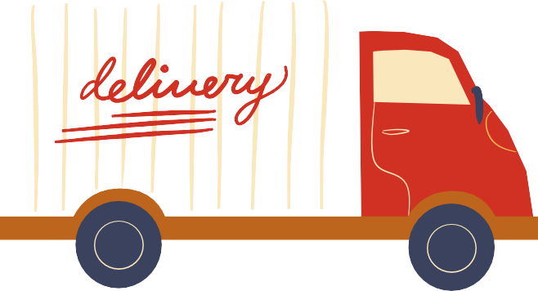

Slide 11

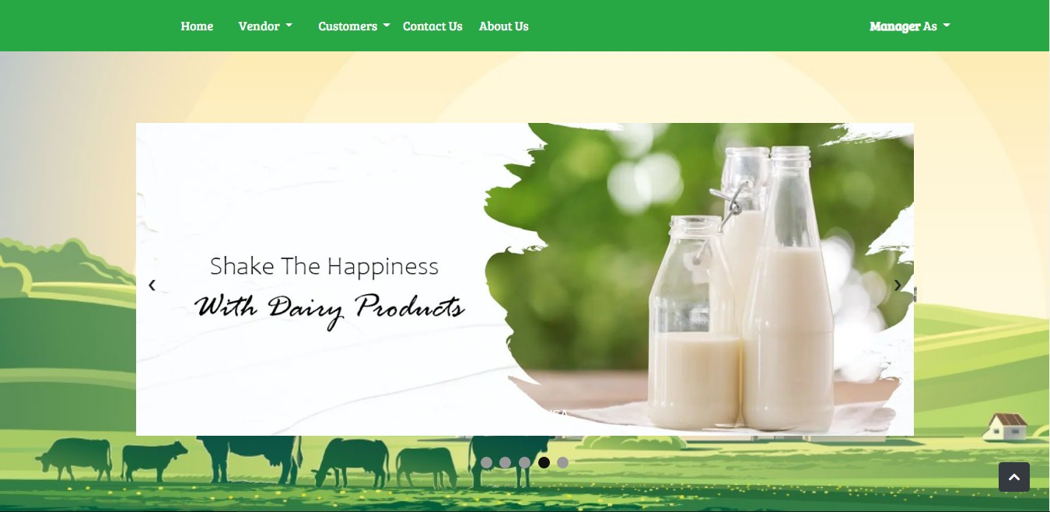
OUTPUTS::
HOME

Slide 12
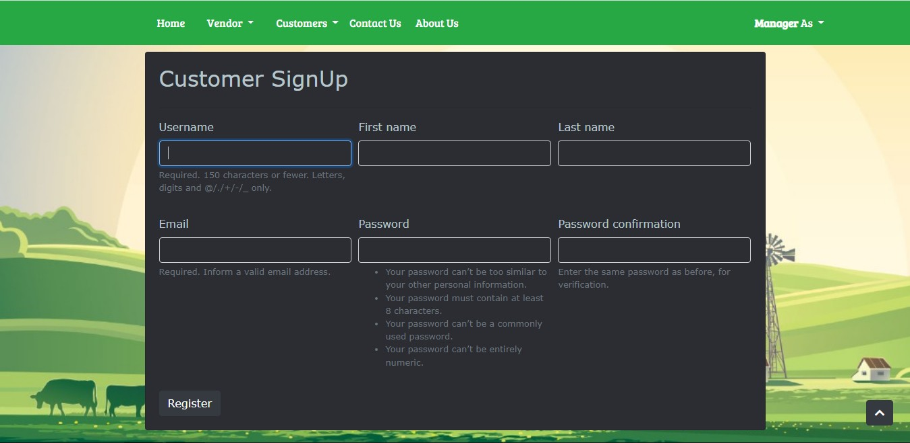

Slide 13
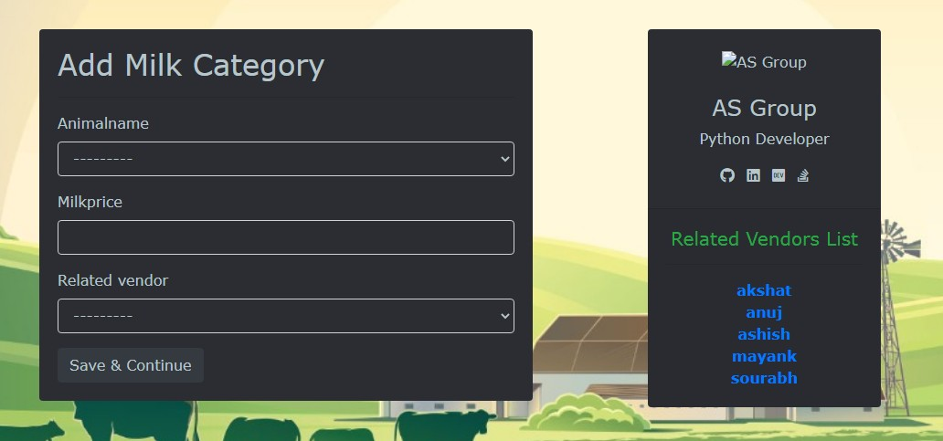

Slide 14
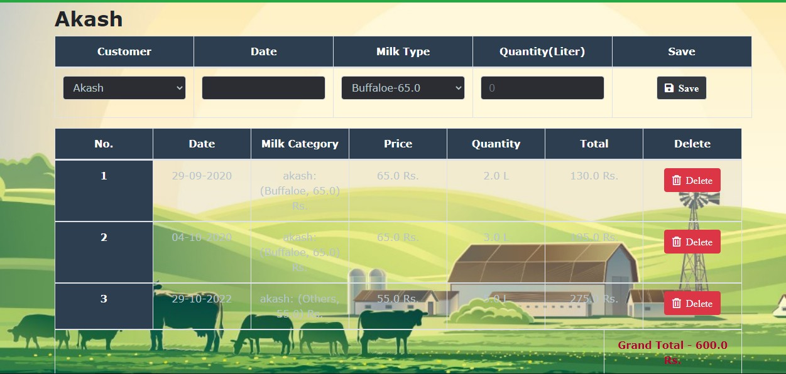

Slide 15








Thank you for listening!
Don't hesitate to ask any questions!

